Slide 1
Unit 6
By: Mohit Goel

Slide 2
Augmented Workforce
An augmented workforce is a situation where human workers cooperate with digital workers, cobots or intelligent virtual assistants to improve safety and efficiency of work. This means that intelligent automation lies at the core of the augmented workforce.
3 technologies that augment your workforce
1. Digital workers
Digital workers are a kind of semantic automation tool that combines RPA (Robotic Process Automation) with conversational AI. Through chat services like Slack, WhatsApp, and others, people can interact with digital employees as if they were conversing with a coworker.

Slide 3
2. Intelligent virtual assistants
Intelligent virtual assistants (IVA) are another example of semantic automation tools that augment the workforce. Alexa, Siri and Google Assistant are famous examples of IVAs. They can communicate with people like digital workers thanks to conversational AI. Thus, digital workers and IVAs generally share features, advantages, and capabilities.
3. Cobots
Cobots, or collaborative robots, increase the workforce for manufacturers. They can collaborate with their human coworkers through their sensors, intelligence, and design features that ensure their safety

Slide 4
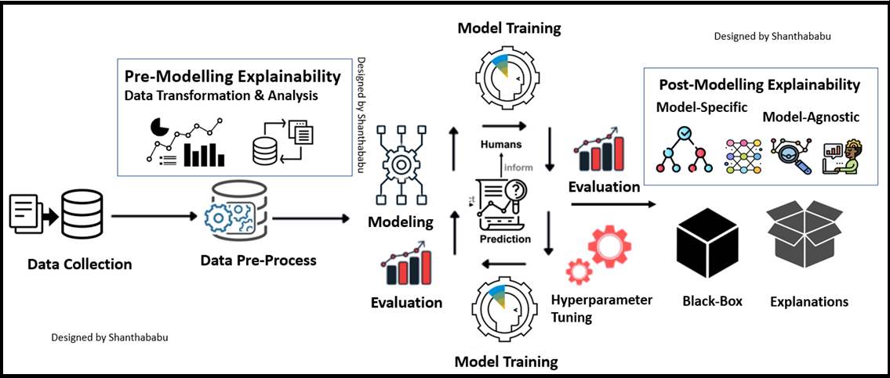
Explainable AI

Slide 5
Explainable AI
Explainable AI is a set of tools and frameworks to help you understand and interpret predictions made by your machine learning models, natively integrated with a number of Google's products and services. With it, you can debug and improve model performance, and help others understand your models' behavior.

Slide 6


Slide 7
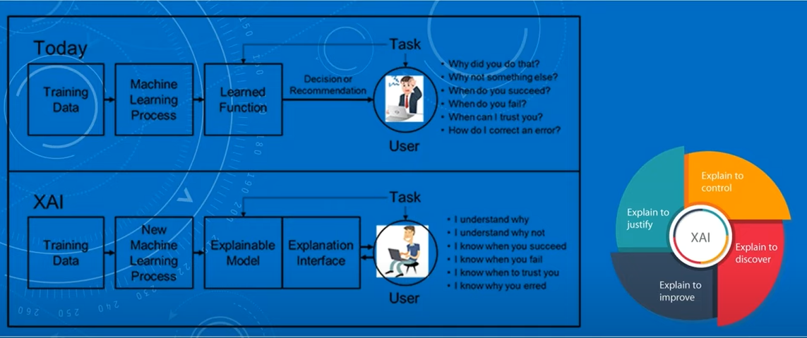

Slide 8
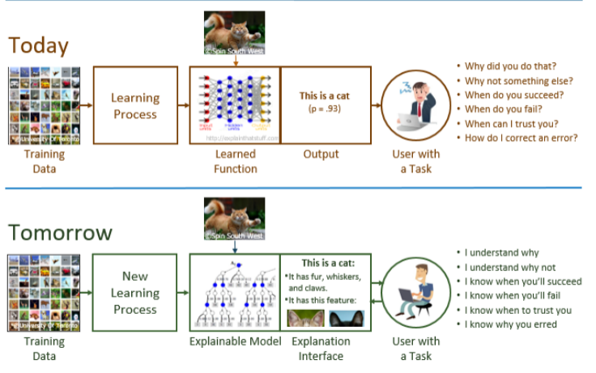

Slide 9
AI and the metaverse
With the help of AI, the Metaverse is closer realization than ever as Artificial Intelligence is playing a crucial role in making this vision a reality, from generating realistic environments to enabling natural language interactions. The metaverse has the potential to transform the way we interact with each other and the digital world, and AI is the enabler – making this happen. AI plays a key role for providing a more immersive and engaging virtual experience for users.
The enabling potential of AI in the metaverse goes beyond mere technological advancements – it can also foster social equity, accessibility, and inclusion. AI-powered tools have the potential to make the metaverse more accessible, inclusive, and empowering for all users, by providing a range of tools and features to help them interact with the virtual environment.

Slide 10

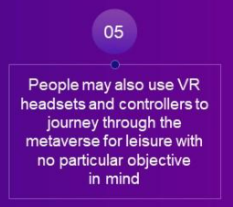

Slide 11
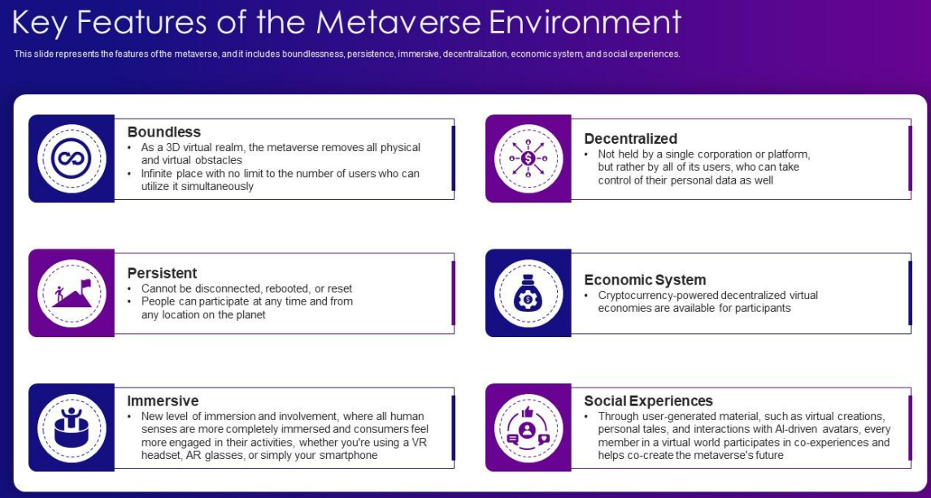

Slide 12
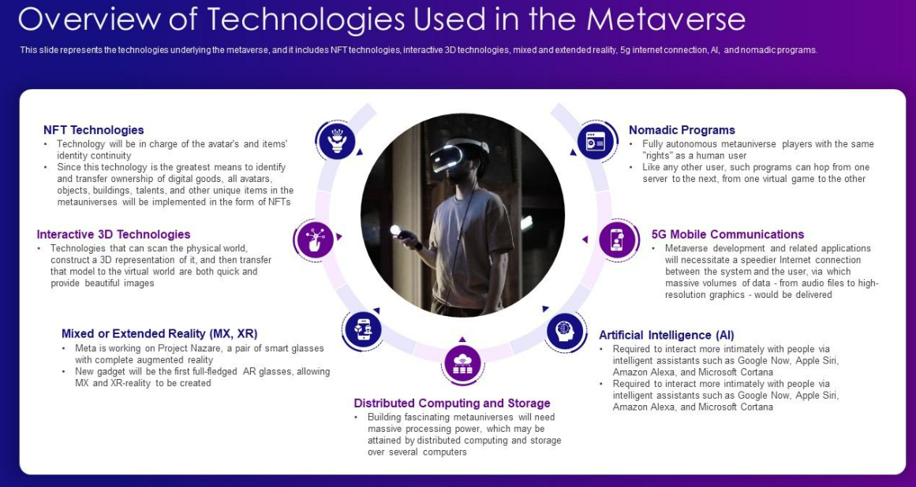

Slide 13
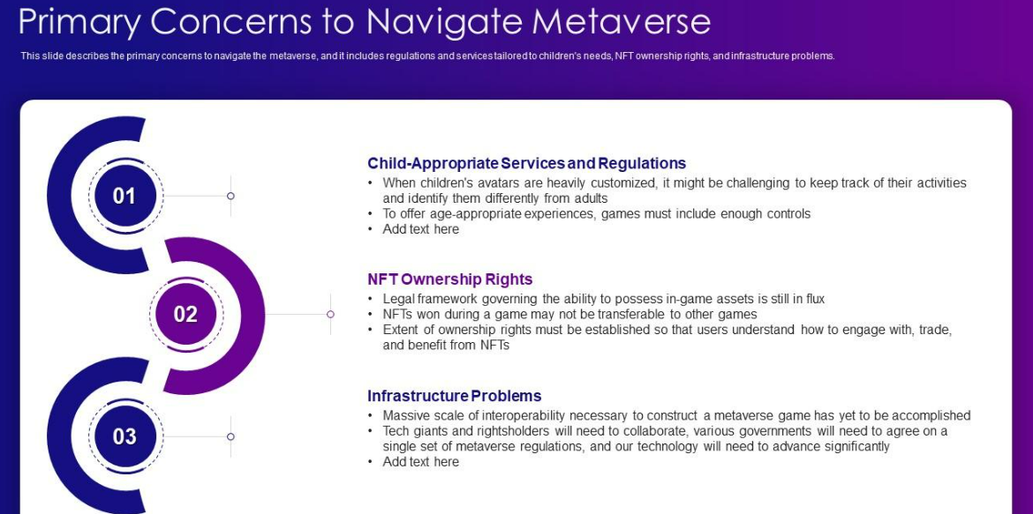

Slide 14
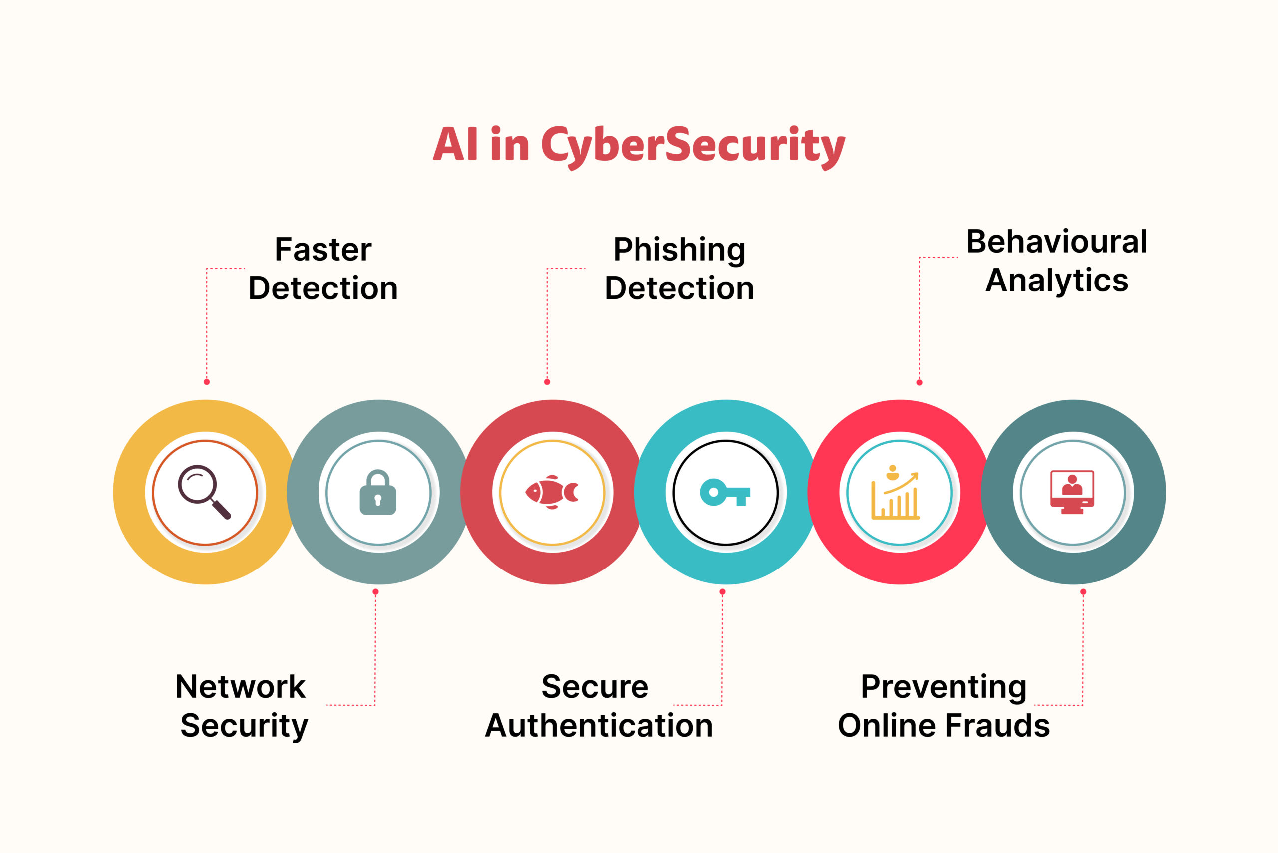

Slide 15
Autonomous Vehicle
What is a self-driving car?
A self-driving car (sometimes called an autonomous car or driverless car) is a vehicle that uses a combination of sensors, cameras, radar and artificial intelligence (AI) to travel between destinations without a human operator.
How self-driving cars work
AI technologies power self-driving car systems. Developers of self-driving cars use vast amounts of data from image recognition systems, along with machine learning and neural networks, to build systems that can drive autonomously.

Slide 16
#1: Detection Algorithms
Autonomous vehicles have neural networks and specific algorithms. These are Artificial Intelligence (AI) and Machine Language (ML) based object detection algorithms. These serve to collect data, analyze objects, and make accurate decisions while on the road. These features also enable these intelligent machines to provide solutions to problems occurring in advance of real time by predicting events through the swift processing of data.
For example, autonomous vehicles can predict a potential threat like a car collision ahead or behind and take a decision in real time to avert it. With good data collection sensors, these pieces of information are processed and results are obtained as actions

Slide 17
#2: Autopilots
Quite recently, Tesla manufactured electric cars that are self-driving and equipped with autopilots to enable automatic steering, accelerating braking, lane changing, and parking actions.

Slide 18
#3: AI-enhanced Features
In recent times, some automotive companies have manufactured autonomous vehicles with enhanced AI features like personal AI assistants, radar detectors, and cameras, all of which serve to prioritize security among other functions. These self-driving cars have implemented AI-enhanced features which are a huge advancement over their predecessors. Self-driving can learn about traits exhibited by the driver like driving speed, preferred car temperature, driving mood, observance of traffic signs, regular songs, or favorite radio stations. By rating driving skills, these autonomous vehicles have helped to change bad driving behaviors and habits.

Slide 19
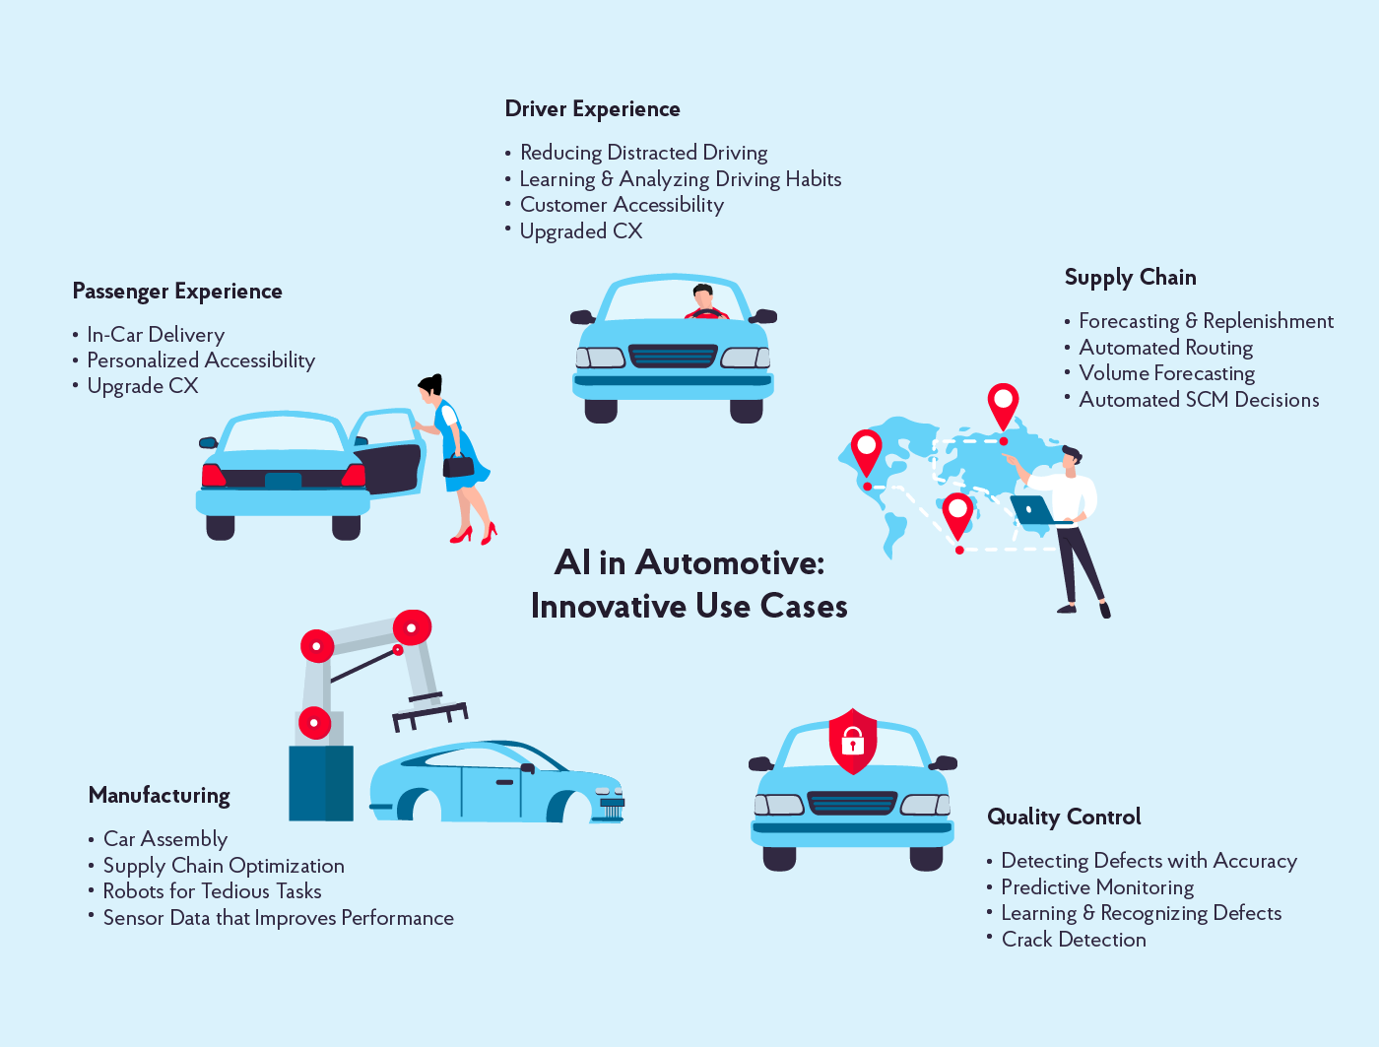

Slide 20
Thank You

